Slide 1

Distributed systems
Distributed systems are hard
Types of distributed systems
Properties of distributed systems
Performance, security, scalability, availability, consistency
[ CS 340/440, CS 345/445 ]

Slide 2
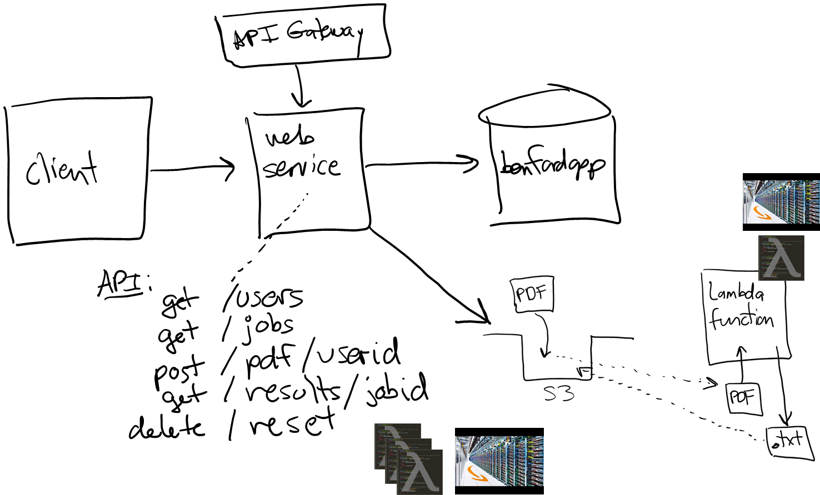
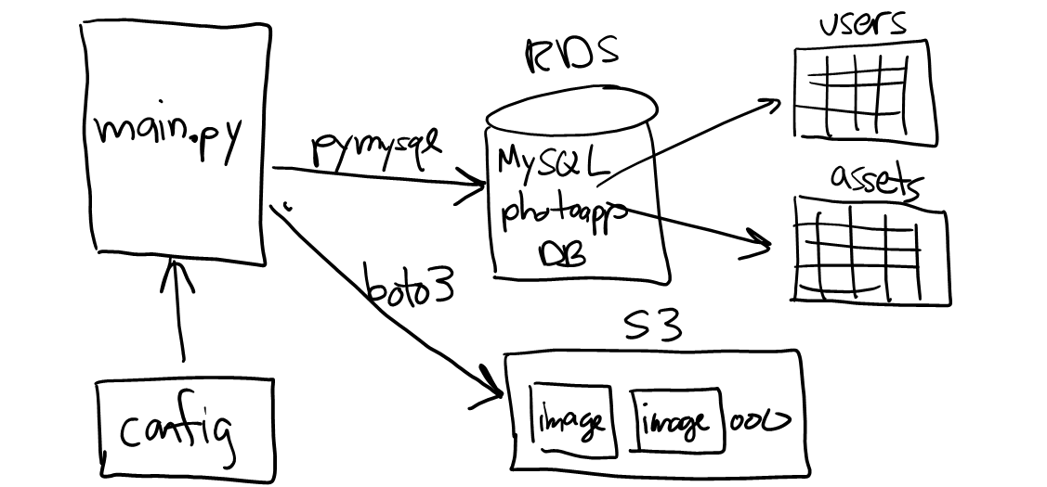
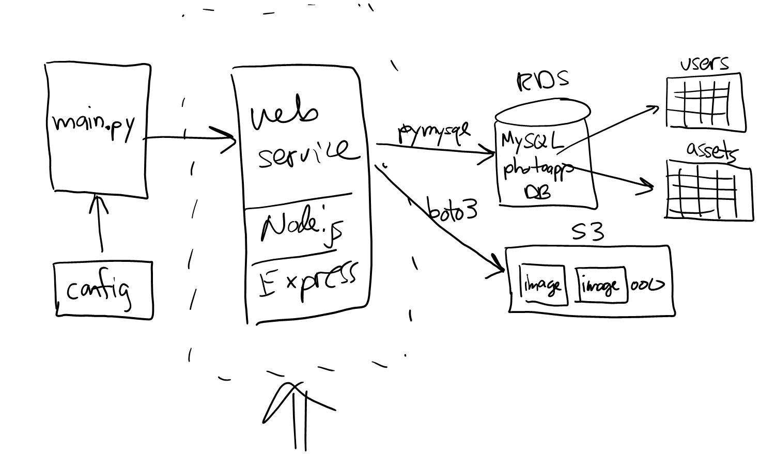
Distributed systems
Cloud-based apps are distributed systems
N > 1 computer programs communicating via messages
All our projects are distributed systems:

Slide 3
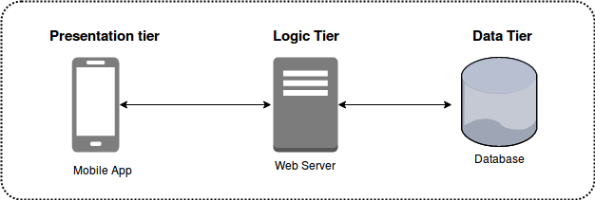
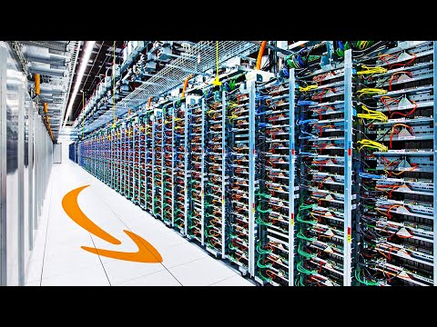
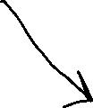
Our projects: basic multi-tier design

Slide 4
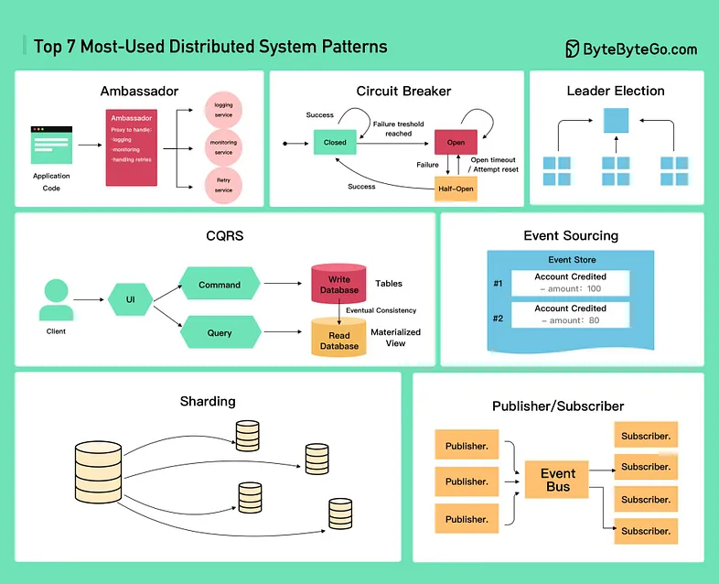
Notes:
Ambassador pattern allows common logic (e.g. logging, monitoring) to be reused across services
Circuit breaker pattern prevents cascading failures…
CQRS = Command and Query Responsibility Segregations, which separates read and updates to a data store. In complex apps, can help separating and optimizing read operations.
Sharding breaks a data source across machines (vs. partitioning which splits a table within one machine)

Slide 5
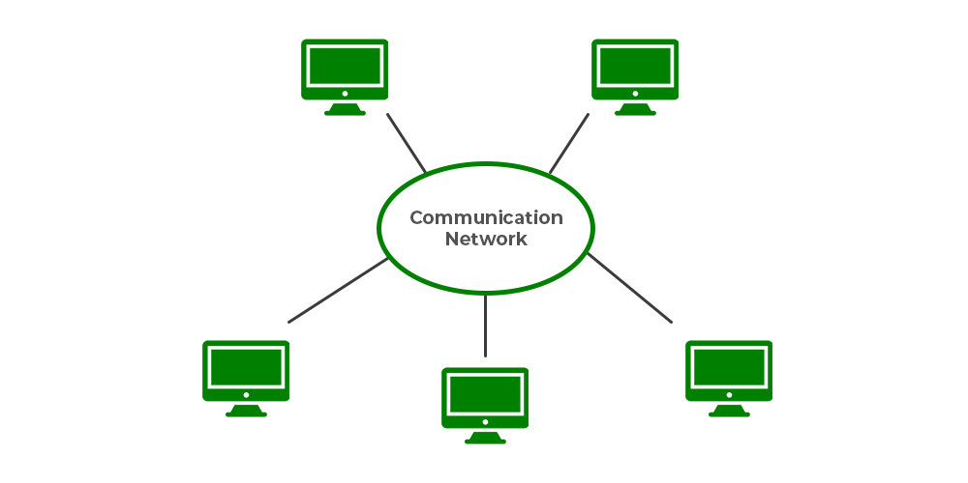
Distributed systems are HARD
Distributed systems are HARD to build
What if the network goes down?
What if one of the machines crashes?
How to secure? What if one of the machines is hacked?
How to prevent hackers from impersonating a machine?
Courses in distributed systems: CS 345/455
Notes:
What if DB update is successful, but S3 update fails? Or vice-versa? This speaks to the "consistency" property of a distributed system --- a consistent view of the system.

Slide 6
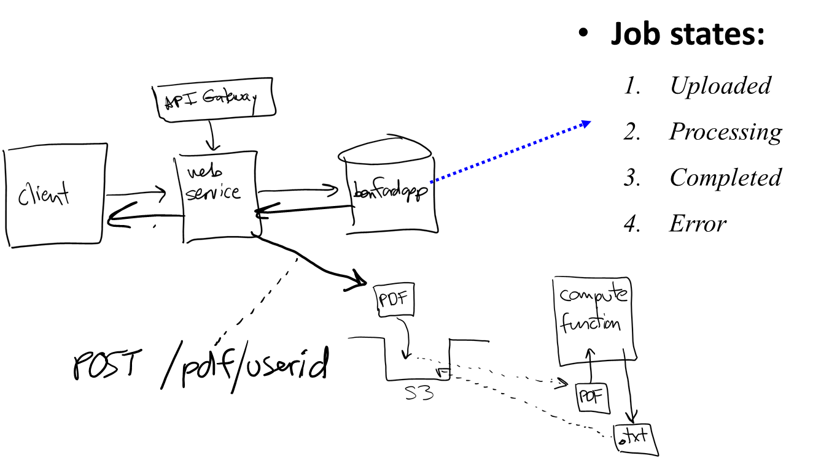
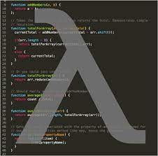
Example
Example:
In project 03, POST /pdf uploads PDF to S3 & updates DB
What scenario(s) did we ignore in programming proj03_upload?
Notes:
What if DB update is successful, but S3 update fails? Or vice-versa? This speaks to the "consistency" property of a distributed system --- a consistent view of the system.

Slide 7
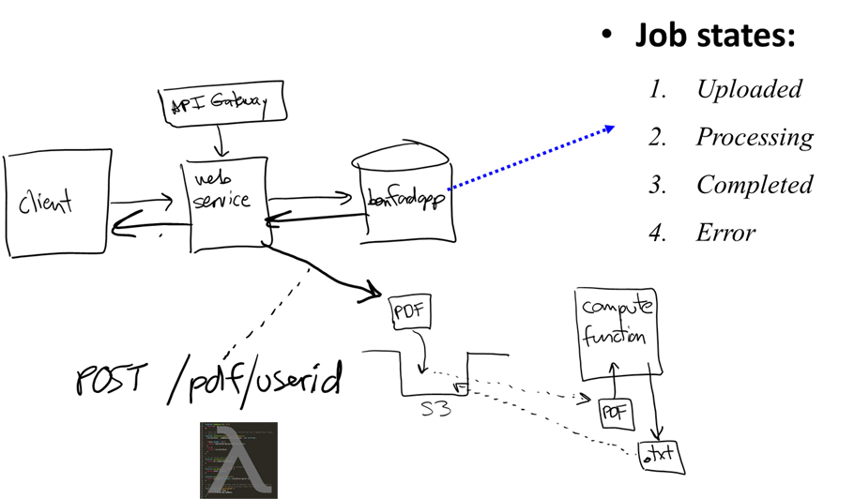
Answers
In the proj03_upload function:
What if the PDF upload works but the update fails?
What if the DB update works but the upload fails?
If PDF upload fails, should we retry? How many times?
If the DB update fails, should we retry? How many times?
How do we get errors back to the client in all cases?
Notes:
What if DB update is successful, but S3 update fails? Or vice-versa? This speaks to the "consistency" property of a distributed system --- a consistent view of the system.

Slide 8
Properties of distributed systems
The most important properties to consider:
Performance (latency, bandwidth, throughput)
Scalability
Security
Availability / fault tolerance
Consistency
8

Slide 9
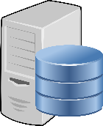
Availability / fault tolerance
Computers crash, it will happen…
Only way to keep your system available is with multiple computers
A system that keeps running in presence of failures is fault tolerant
Load Balancer
9

Slide 10

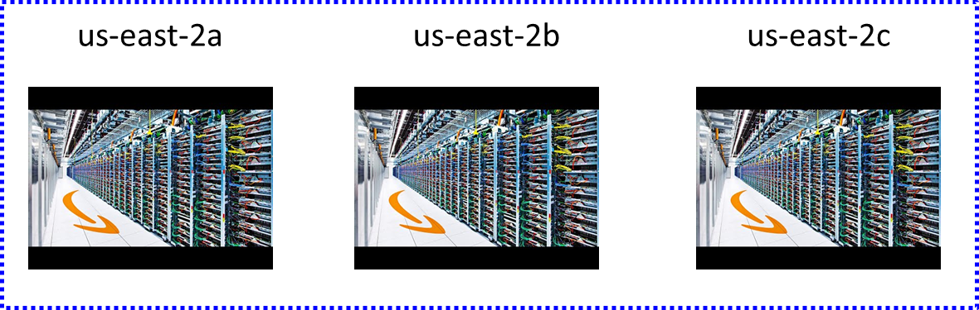
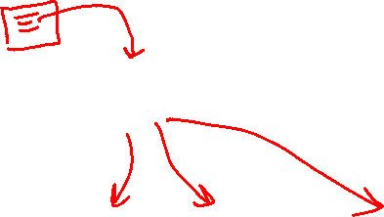
Example: S3 is fault tolerant
Buckets are replicated across all sites in a region in case one of the sites loses power / network connectivity…
Ohio (us-east-2)

Slide 11
Interesting question…
Replicating data leads to an interesting problem…
If we upload an image to S3, how soon is it available in all 3 sites?
What if a download request is routed to a site that hasn't finished replicating? What happens? What does AWS guarantee, if anything?
Ohio (us-east-2)
Notes:
Come back for the answer in the next recording!

Slide 12
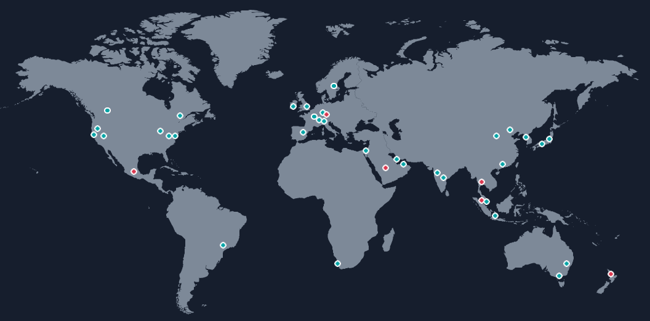
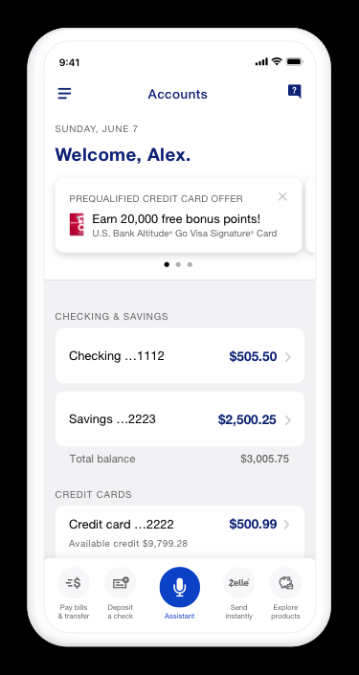
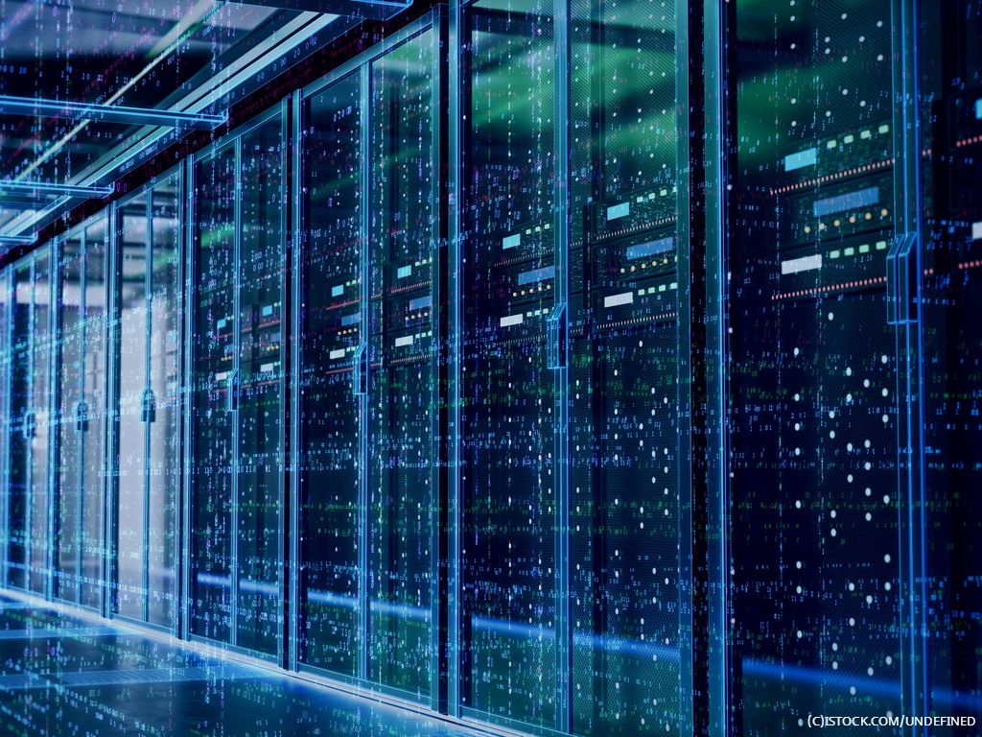
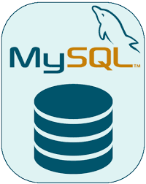

Another version of the same question…
Suppose a bank account has exactly $1,000
How does the bank prevent two different people from withdrawing $1,000 from that account at the same time?
12

Slide 13
That's it, thank you!

